Slide 1
Improving Transparency and Fairness in Loan Approval Algorithms Through Explainable AI
Final Class Project – Two-Person Team

Slide 2
Table of contents
01
02
03
04
What is the problem?
Why is this an interesting problem?
How did we tackle the problem?
Findings

Slide 3
01
What is The Problem?
(AI)

Slide 4
What is The Problem?
Lack of Transparency in Loan Approval: Loan approval algorithms are often "black boxes," making decisions without clear explanations.
Bias in Decision-Making: These algorithms may inadvertently discriminate based on race, gender, or income, leading to unfair loan denials or approvals.
Impact on Marginalized Groups: Discriminatory decisions disproportionately affect marginalized groups, exacerbating economic inequality.

Slide 5
02
Why is This an Interesting Problem?
(AI)

Slide 6
Why is This an Interesting Problem?
Ethical and Economic Justice: Access to fair financial opportunities is a critical aspect of economic justice.
Bias in AI: Machine learning models in financial systems can perpetuate historical biases, making it essential to address these issues.
Relevance to Current AI Debates: There is increasing concern over AI's role in societal outcomes, especially in high-stakes areas like finance.
Innovation in XAI: Few studies have applied Explainable AI (XAI) techniques to loan approval systems, making this research particularly relevant.

Slide 7
03
How Did We Tackle The Problem?
(AI)

Slide 8
How Did We Tackle The Problem?
Dataset: We analyzed the Home Mortgage Disclosure Act (HMDA) 2022 dataset for New Jersey, focusing on factors like race, gender, income, and loan outcomes.
Data Cleaning & Preprocessing: We handled outliers, missing values, and ensured consistency in variables like race and income.
Use of XAI: We applied fairness algorithms and XAI techniques (e.g., SHAP) to enhance the transparency and interpretability of loan decisions.
Modeling: We tested multiple machine learning models, including Logistic Regression, Random Forest, and XGBoost, to assess fairness and accuracy.

Slide 9
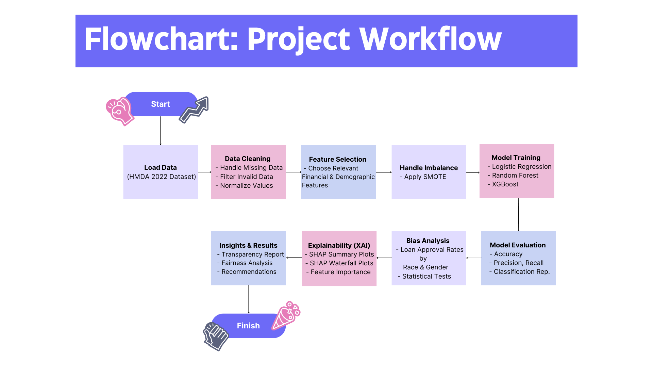

Slide 10
04
Findings
(AI)

Slide 11
Findings
Biases Identified:
Race: Significant disparities in loan approval rates between racial groups, with White and Asian applicants having higher approval rates.
Income: Higher income levels correlated with higher approval rates.
Gender: Minor gender differences, but statistically significant.

Slide 12
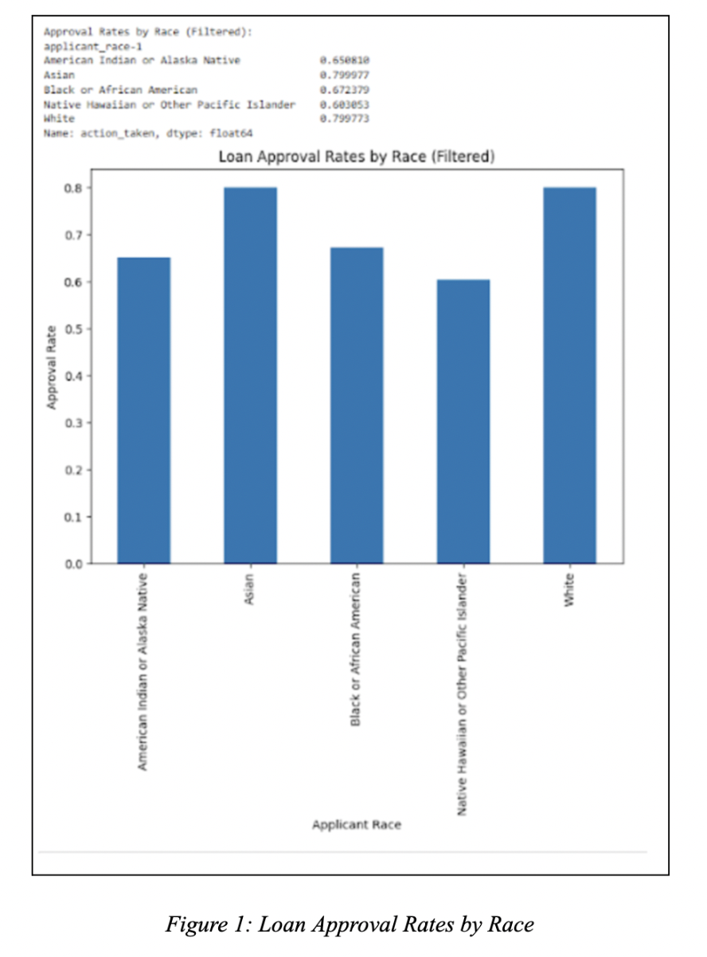
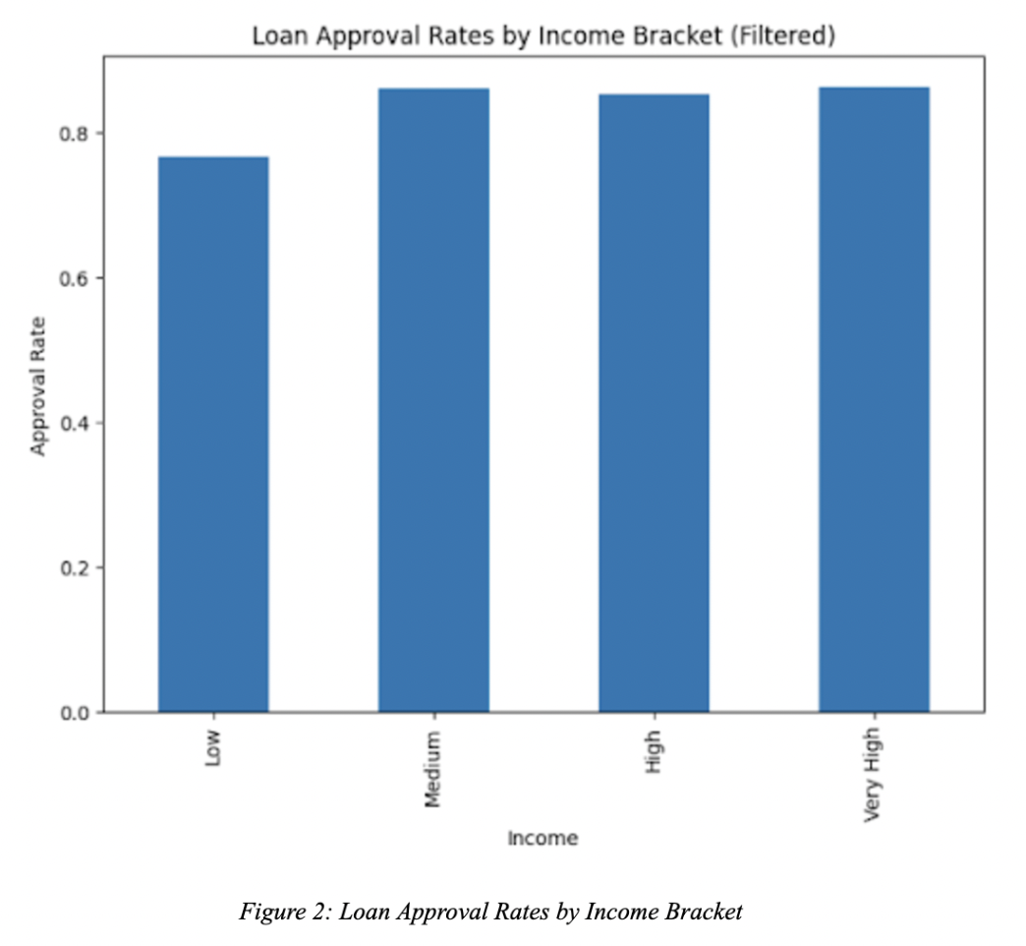

Slide 13
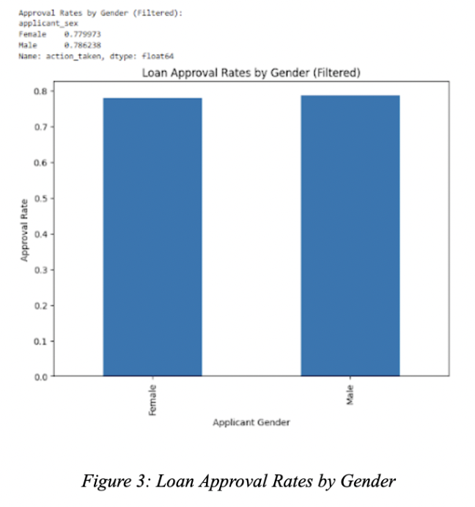

Slide 14
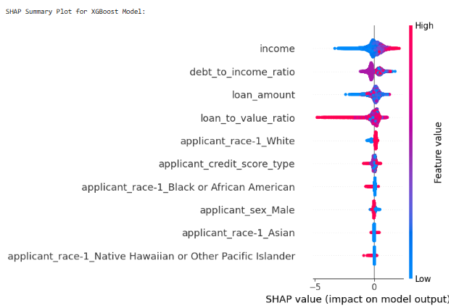
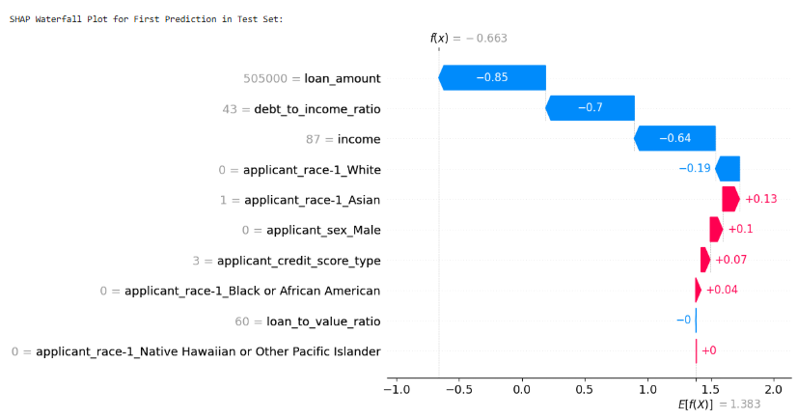
Figures 4-5: SHAP Waterfall Plot Analysis

Slide 15
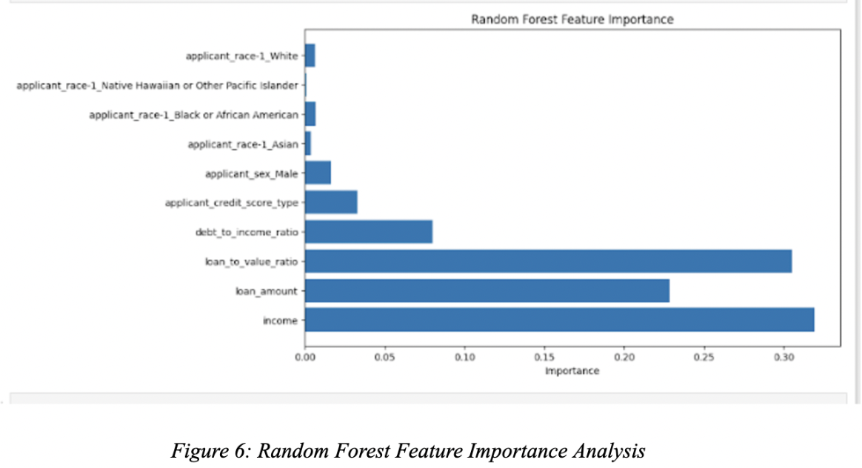

Slide 16
Findings
Loan Amount and Debt-to-Income Ratio: Key reasons for loan denials
Income: A primary driver for approvals.
Demographic Influence: Race and gender play a smaller role but may still cause bias.

Slide 17
Conclusion
Bias Exists: Significant biases related to race and income were identified in loan approval processes.
XAI Helps: Using XAI techniques such as SHAP improves model transparency, but it’s not a complete solution to bias.
Next Steps: Additional work is needed to improve recall for loan rejections and to further refine fairness algorithms in loan approval systems.

Slide 18

Thank You!

